Slide 1
Movies and series
10. Time expressions and past continuous

Slide 2
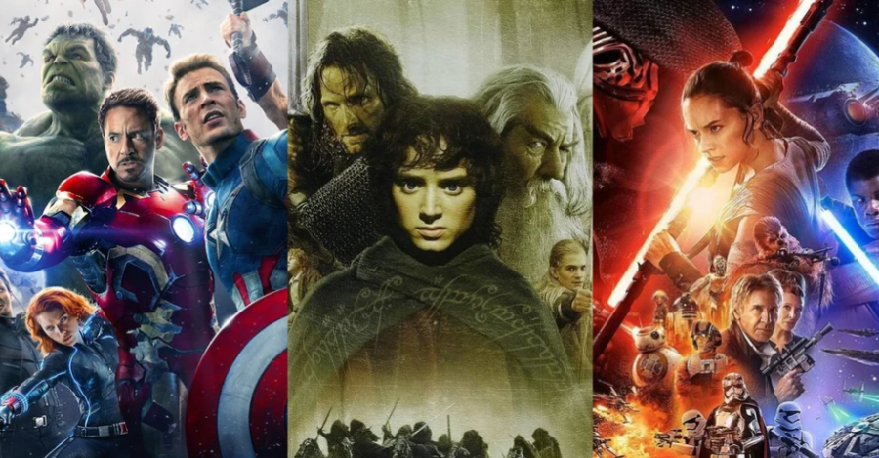
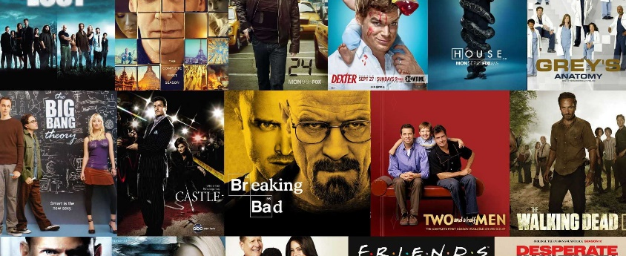
Movies and series
What is your favorite movie? Why?
What is your favorite series? Why?
What happens in them?

Slide 3
Time expressions
Past Actions or Events | Present Actions or Events
In the past | These days
Ten years ago/ a month ago / two weeks ago | Nowadays
Last year / last winter | Today
In those days | Now
Example:
In the past, we rented movies from Blockbuster.
Nowadays, we watch them on Netflix.

Slide 4
Complete the sentences
in the past today nowadays a month ago last July these days in those days two days ago
Peter used to be a poor actor. ______ he is a celebrity.
______ , men proposed to women. Now women sometimes propose to men.
Larry asked Harriet out on a date ______. She’s meeting him for dinner tonight.
Ben used to be very shy, but ______ he has no problem asking girls out.
In the past, dating used to be so romantic. ______ things are different.
Peter only met Sheila ______ and he proposed last week, after only dating Sheila for two weeks. He says it was love at first sight!
My parents met when they were 18 and got married a year later. ______ people got married when they were young.
Paula began working as a summer camp manager ______. Now, a year later, she is still enjoying her job there.
Notes:
1. These days / Today / Nowadays
2. In the past
3. two days ago
4. these days / today / nowadays
5. These days / Today / Nowadays
6. a month ago
7. In those days
8. last July

Slide 5
Before and after
Before and after help us to distinguish which action happened first and second.
I ate dinner before I washed the dishes. / Before I washed the dishes, I ate dinner.
I drank coffee after I woke up. / After I woke up, I drank coffee.
*Later is used to mention some unspecified time in the future.
I will talk to you later.

Slide 6
During and while
During and while are used to show that the actions happened at the same time or during the same period of time.
During + Noun. When something happened.
I met Sandra during my first year at college.
While + Subject + Verb. Two things happen at the same time.
I met Sandra while I was at college.

Slide 7
Use after, before, while, during, and later.
I first met Michael 1______ a business trip to England. He was the manager of a small restaurant in London. Michael asked me out on a date, but unfortunately, I returned to the U.S.A. 2______ we had a chance to see each other again.
I didn’t think much about Michael 3______ that. I was busy at my job at the newspaper. Two years passed. Then late one afternoon, 4______ I was in a meeting with some other journalists, my editor told me about a wonderful new restaurant in the city. “Write a review about it 5______ someone else does,” he said.
So that evening 6______ work, I went to “Maxine’s” for dinner. It was wonderful! 7______ I was eating dessert, the waiter came up to me and said, “This is from the manager.”
8______ I had a chance to speak, he put a glass of wine in front of me. The manager appeared at my table a few minutes 9______. It was Michael!
What happened next? Well, we fell in love 10______ our first date – the date we had made years ago but hadn’t had until then.
Notes:
1. during
2. before
3. after
4. while
5. before
6. after
7. While
8. Before
9. later
10. during

Slide 8
Past continuous
Subject + was / were + verb ing = I was working.
We use the past continuous when we talk about an activity that was happening at some point in the past.
(+) Peter and I were working last night.
(-) She was not eating healthy last year.
(?) What were you doing yesterday at 7pm?
You can use while when you are doing two things at the same time.
I was taking a shower while I was listening to a podcast.
Notes:
Listening practice.
There was a blackout, and people were doing different activities. STOP AT 1:40
What examples did you hear?
https://www.youtube.com/watch?v=jkOXNxoMClA

Slide 9
Complete the sentences
Julie ______ at 12am last night.
You ______ at 3 pm yesterday.
Luke ______ at 6:30 pm.
John and I ______ last week.
___ you ___ at home last weekend?
He ______ the internet all day yesterday.
Mrs. Brown ______ her flowers when the phone rang.
Dr. Ford ______ his report, so he apologized.
They told us an excuse because they ______ a lot of noise.
I ______ coffee while you ______ breakfast.

Slide 10

Ask your classmates
What were you doing last night at 7 pm?
What did you do before coming to class?
What series or movie did you watch last month?
What series or movie did you watch last weekend?
What series or movie was your favorite when you were a child?
How do you start every day?
Is there a series or movie you always watch?
Do you watch series or movies every day?
What platform do you use every weekend?
Do you think we have better movies nowadays?
Notes:
Past continuous grammar practice
https://www.youtube.com/watch?v=kb3WW09xTX4 Listening practice https://www.youtube.com/watch?v=etvW0FOD_so

